Slide 1
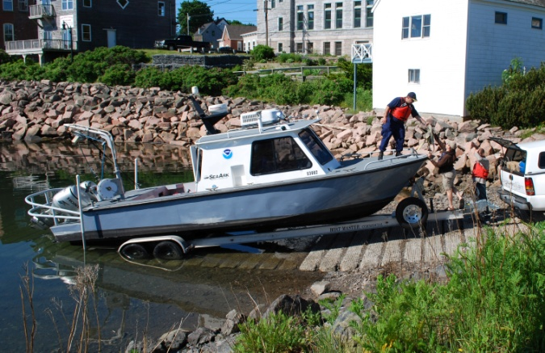
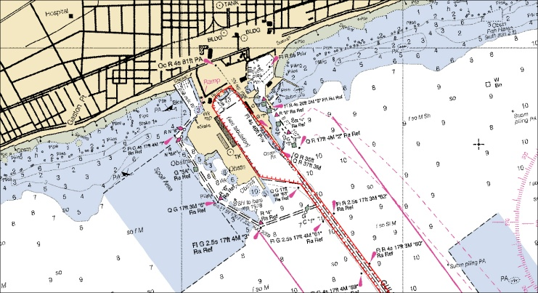
Office of Coast Survey
Captain John Lowell

Slide 2
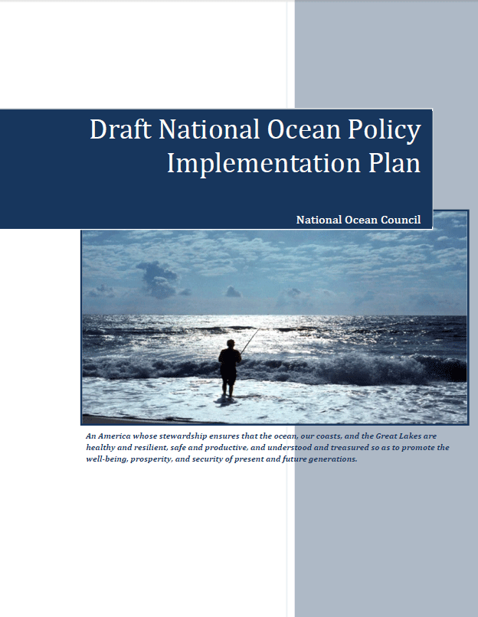
National Priorities
Observations, mapping and infrastructure
Coordinate and support
Changing conditions in the Arctic

Slide 3
Kotzebue Chart 16161
Customer Requirements
AK Navigation Manager meets with constituents, gathers requirements, and proposes a series of new charts for Alaska
Kotzebue is part of the plan

Slide 4
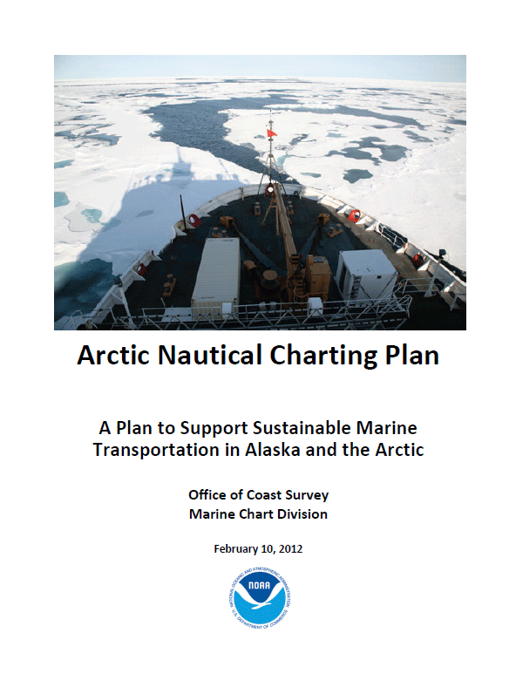
2011 - 2012
Office of Coast Survey formalizes a plan to improve charting in Alaska and the Arctic
http://nauticalcharts.noaa.gov

Slide 5
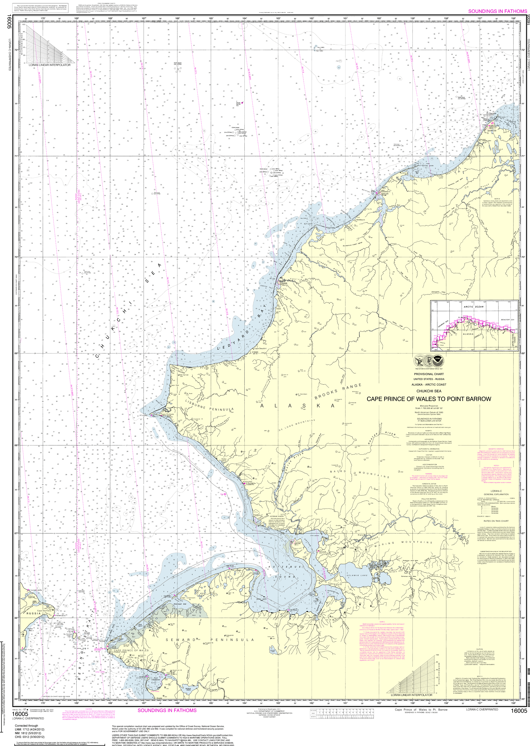
16005
Best available coverage for Kotzebue prior to the release of chart 16161
1:700,000

Slide 6
Kotzebue Chart 16161
Customer Request
Industry and government in Kotzebue request larger scale charting data for 2012 season
Coast Survey management visits Kotzebue in July 2011 and promises a new chart before ice break-up in mid-June 2012

Slide 7
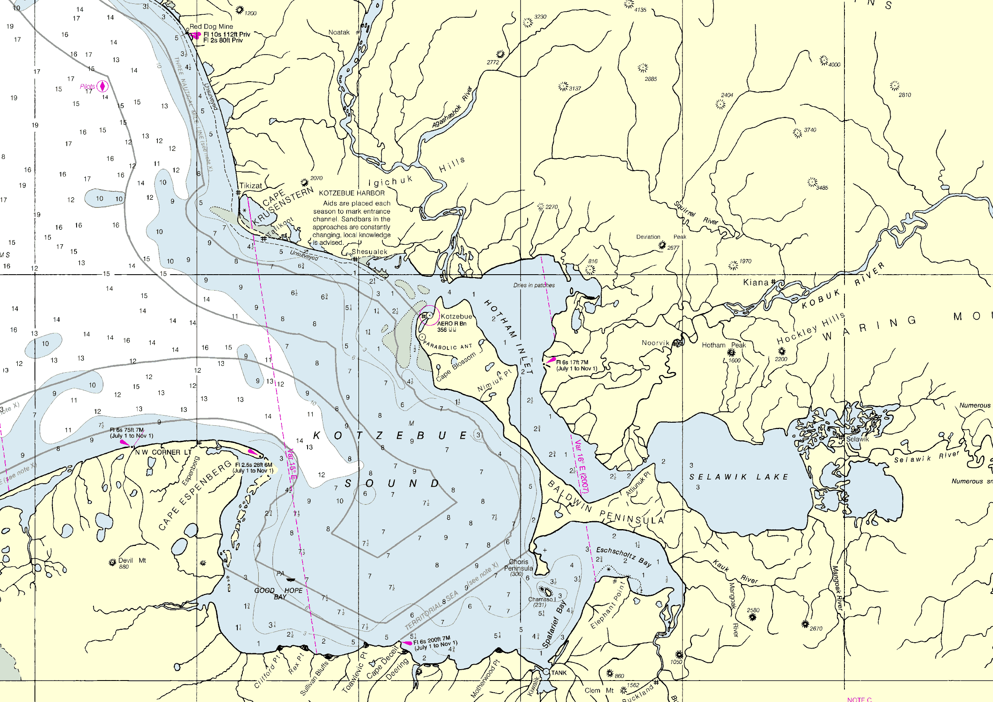
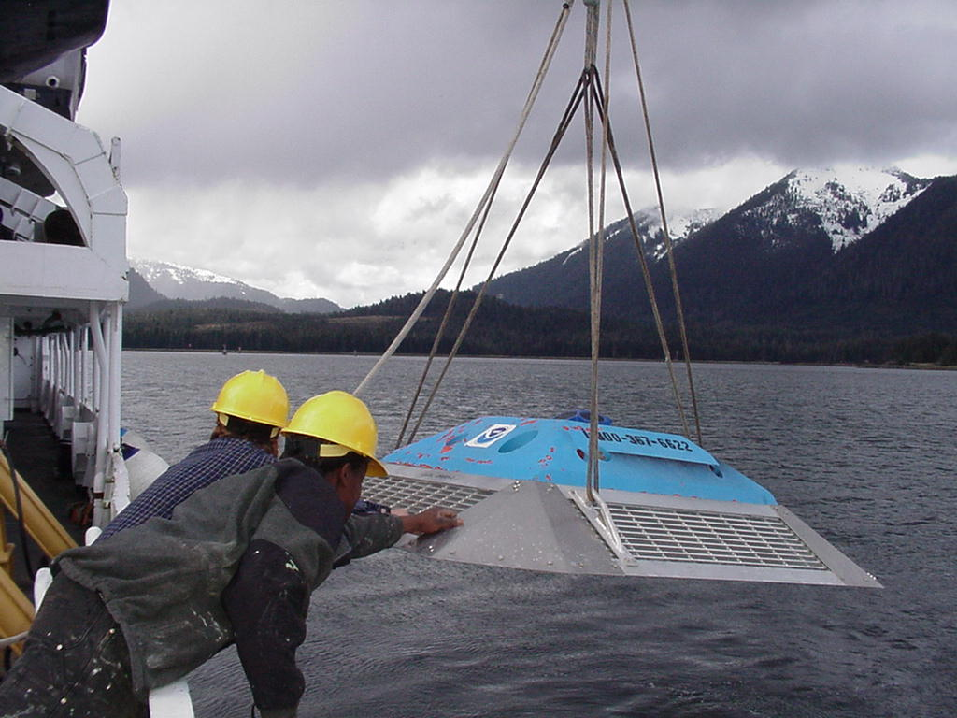
Tides collected
summer 2011
CO-OPS
16005 1:700,000
Notes:
One of the tide stations was dual use for V-datum.

Slide 8
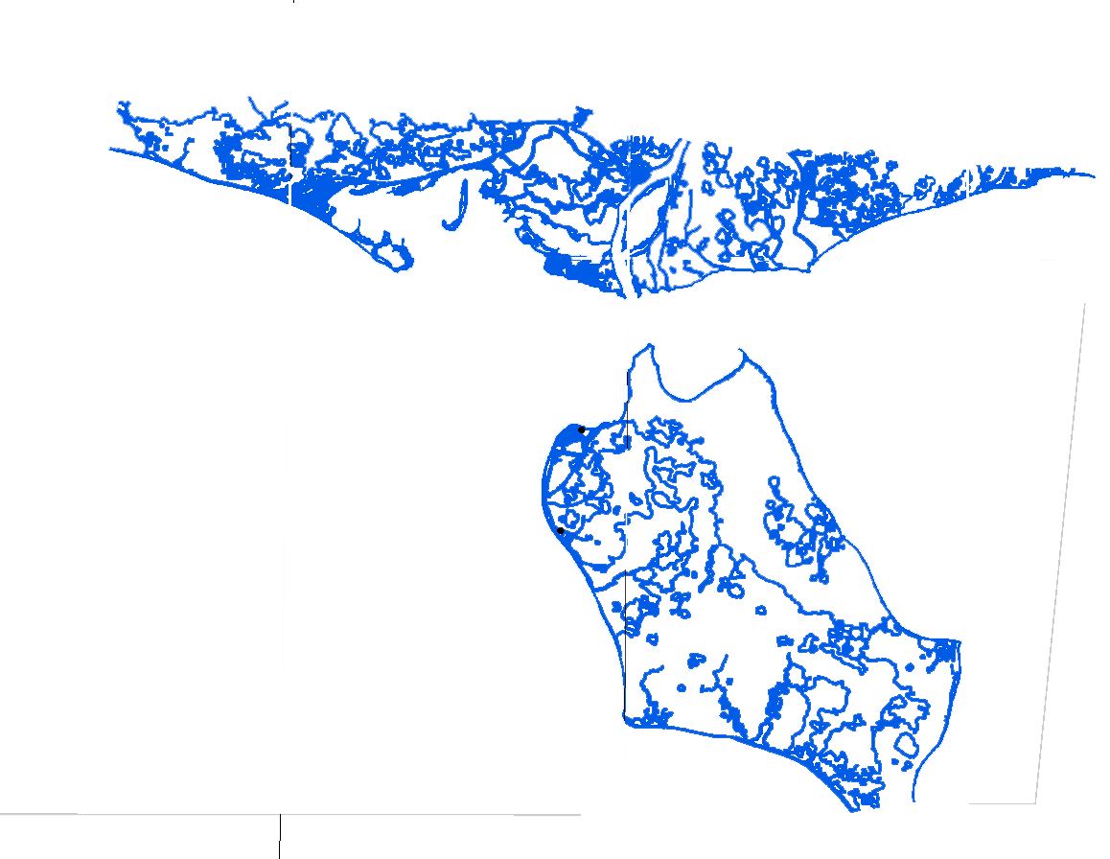
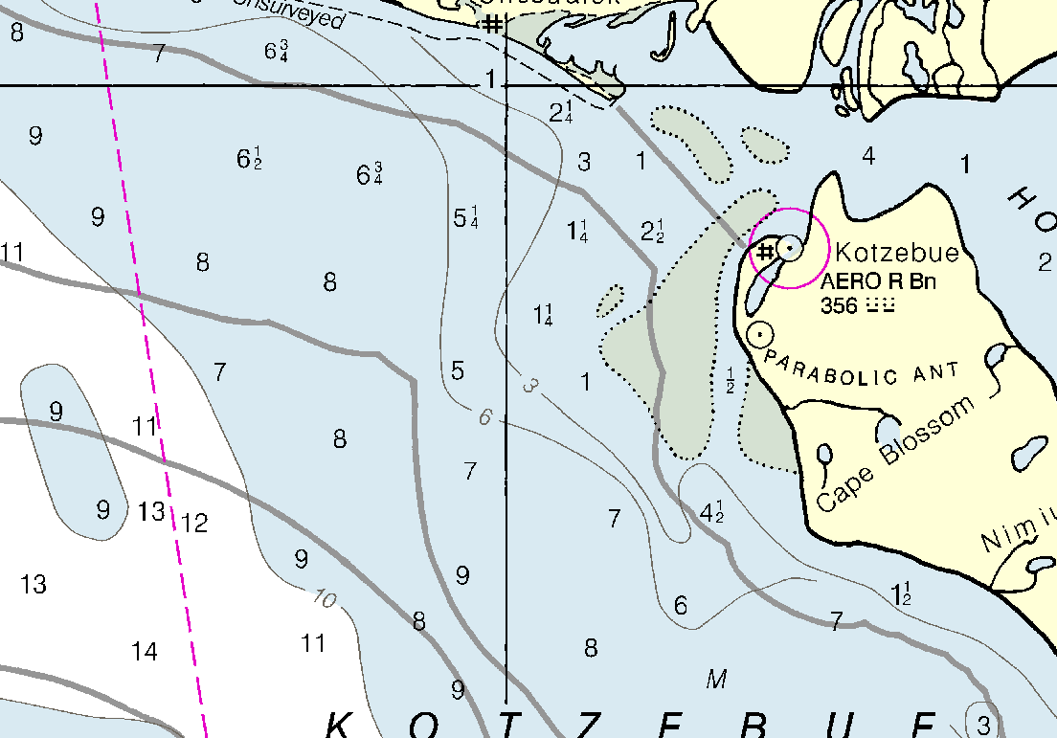
Shoreline collected
October 2011 – February 2012
National Geodetic Survey
16005 1:700,000
Notes:
NGS collected shoreline from satellite imagery

Slide 9
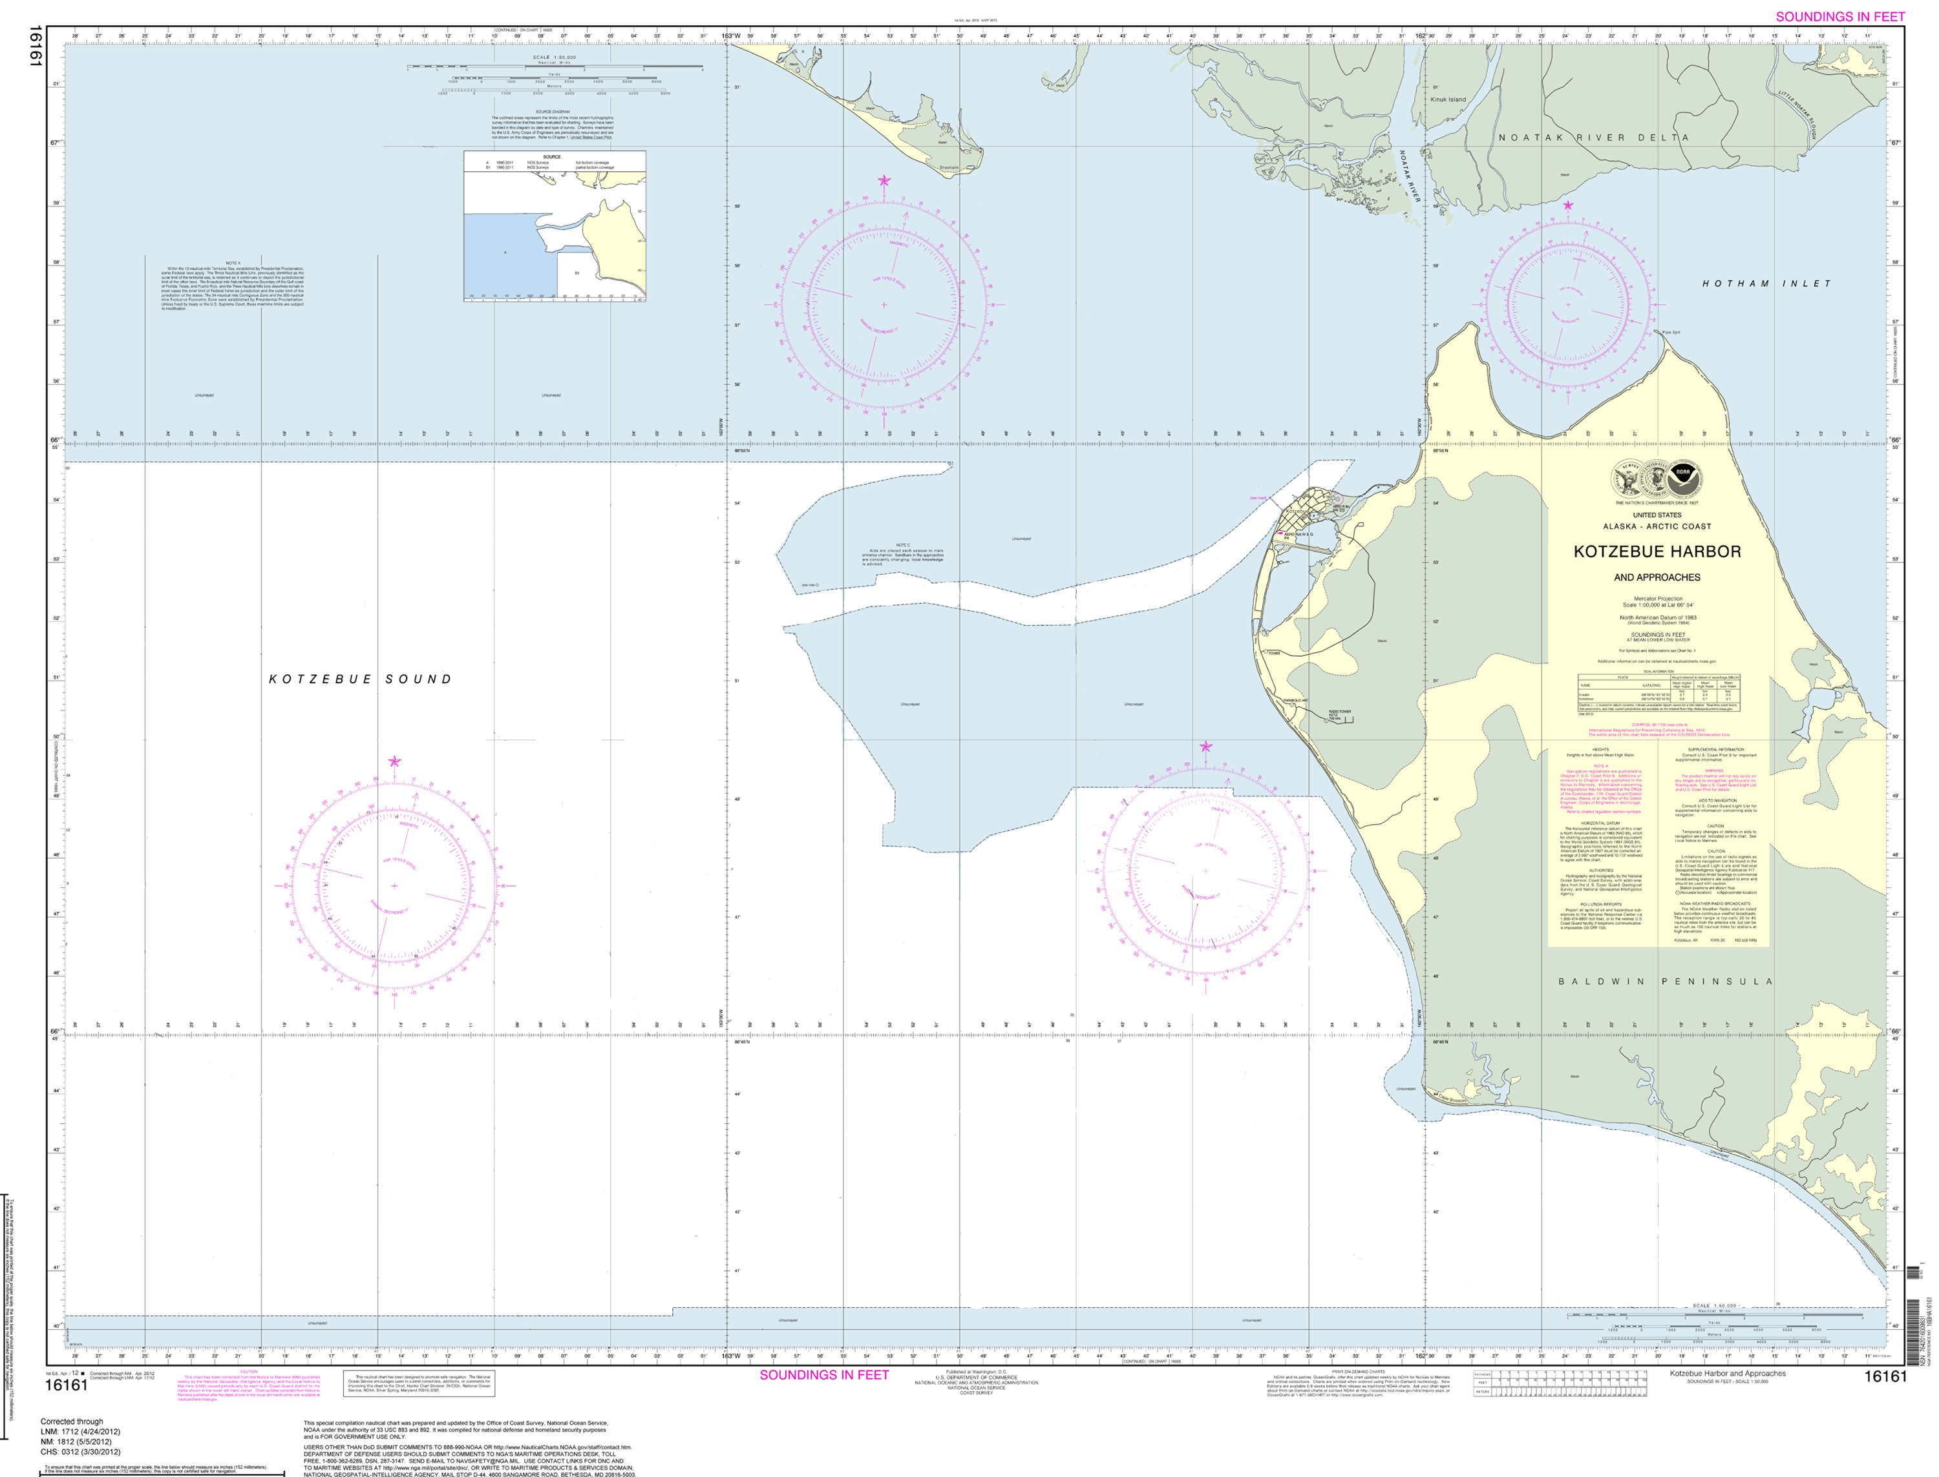
Shoreline applied
16161 1:50,000

Slide 10
Hydrography collected Summer 2011

Slide 11
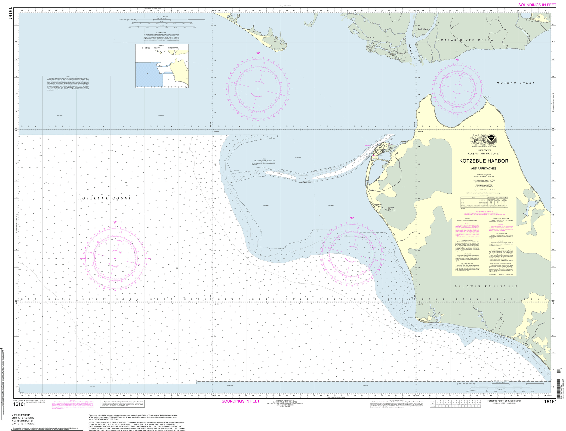
Hydrography applied

Slide 12

Maritime boundaries reviewed
Notes:
Maritime Boundaries: All of the lines in the presentation are maritime boundaries and they were adjusted inward by about 3NM. The closing lines were also adjusted.

Slide 13

1:25,000
Harbor coverage

Slide 14
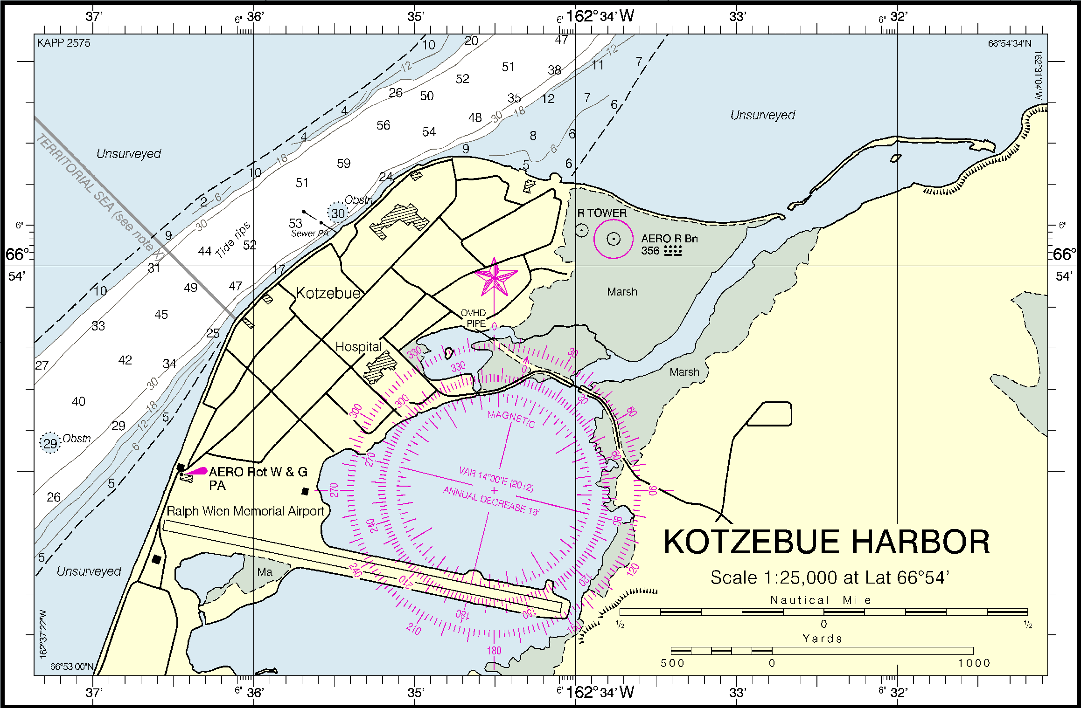

Slide 15
Products for navigation in time for
June ice breakup
Print on Demand – available first week in May
Raster nautical chart – available first week in May
Lithographic chart – end May, beginning June
Electronic navigational chart (ENC) – early June
Coast Pilot update – next new edition will be printed in early August
Notes:
1) Updates for Kotzebue are added to Coast Pilot 9 as they are processed. The next new edition (30th Ed. 2012) of CP 9 will be printed in early August.
2) The 16161 chart polygon was added to the Chapter 9 Chapter map which will appear in the next edition.
3) The 16161 chart polygon was added to the Alaska Chart catalog which will be printed sometime early this summer. I believe this will be the last of the 5 catalogs to be printed.
Coast Pilot update in general:
The development of the XML-based production system for the Coast Pilot is within budget and on schedule. All 9 volumes of the CP are in the new system and they are being maintained there as well. Testing for weekly updates of the Coast Pilot is underway for all nine volumes. Weekly updates of all nine volumes will be available online as HTML, as a Print on Demand book and as a downloadable PDF this summer. Details of Coast Pilot updates are being finalized with the USCG.

Slide 16
Products supported by new charting data
ENC Direct to GIS
Digital Coast – Coastal Resource Management
  Benthic
  Hydrographic
  Marine boundaries
Environmental Response Management Application (ERMA)
Notes:
Add thanks to NWS for providing on-the-spot weather reports and ground support in Kotzebue

